Slide 1
Optimizing Multiple Thermoelectric units for maximum cooling performance
JungHoon Lee 02.25.2021

Slide 2
Introduction
Optimizing TEC size, stacking, voltage and current adjustments
Minimizing wasted heat
Maximizing cooling efficiency(COP)
Compact system

Slide 3
Thermoelectric modules
Uses the Peltier effect to create a heat flux at the junction of two different types of materials
Solid state heat pump
Pros: Small, relatively inexpensive, no moving parts
Cons: poor power efficiency, low COP

Slide 4
Experiment environment, equipment
Experiments were done in a 23~25C(73.4~77F) room
Equipment used: SDM3055, IT6302, DPS5015

Slide 5
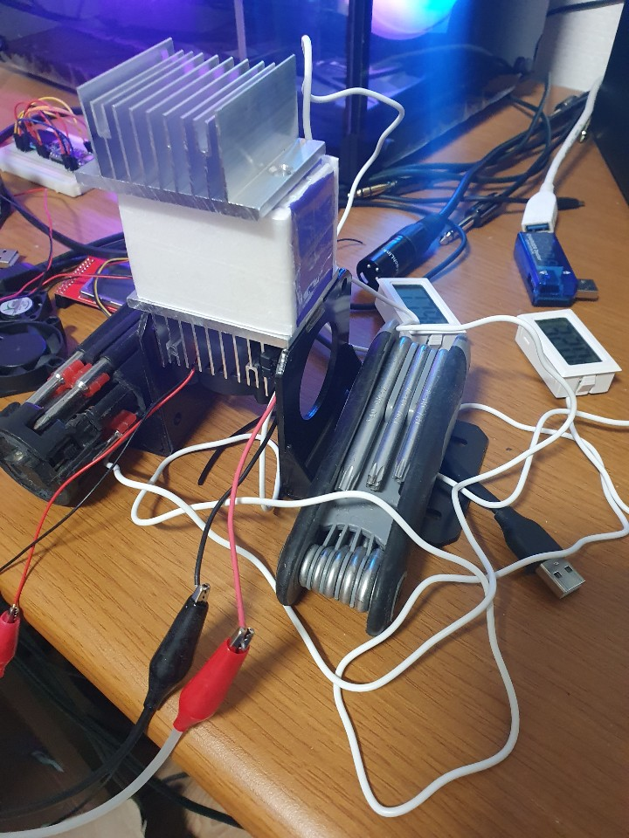
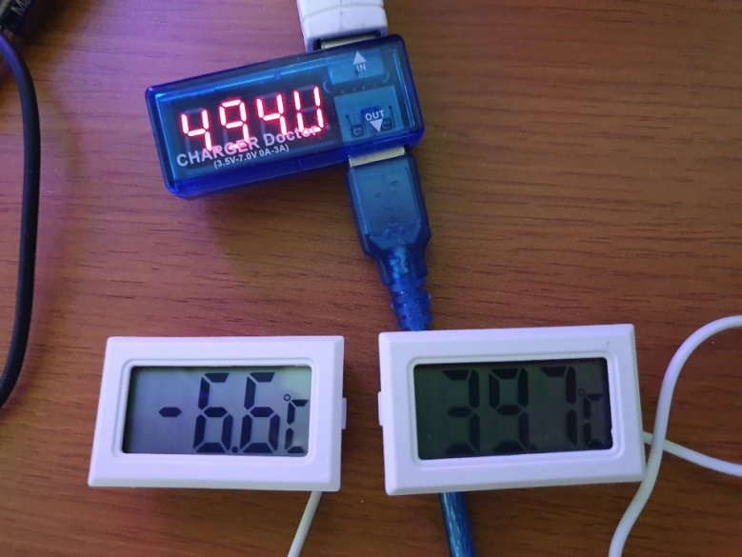
Experiment 1

Slide 6
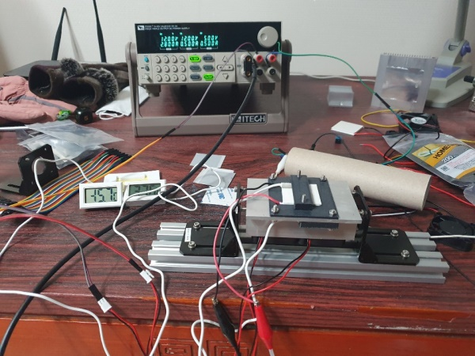
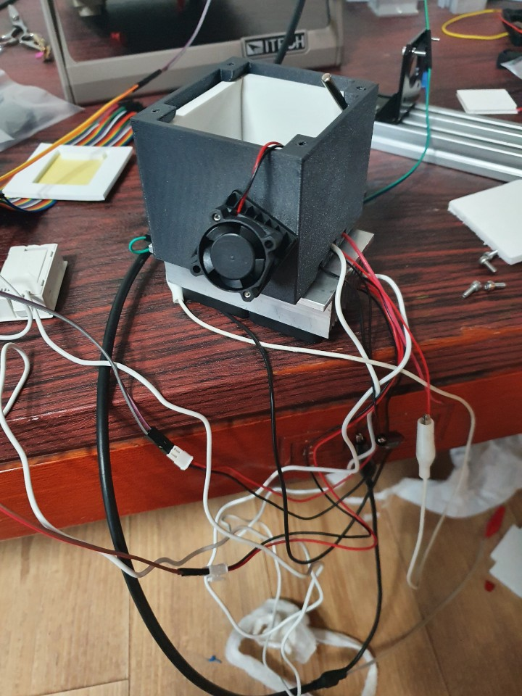
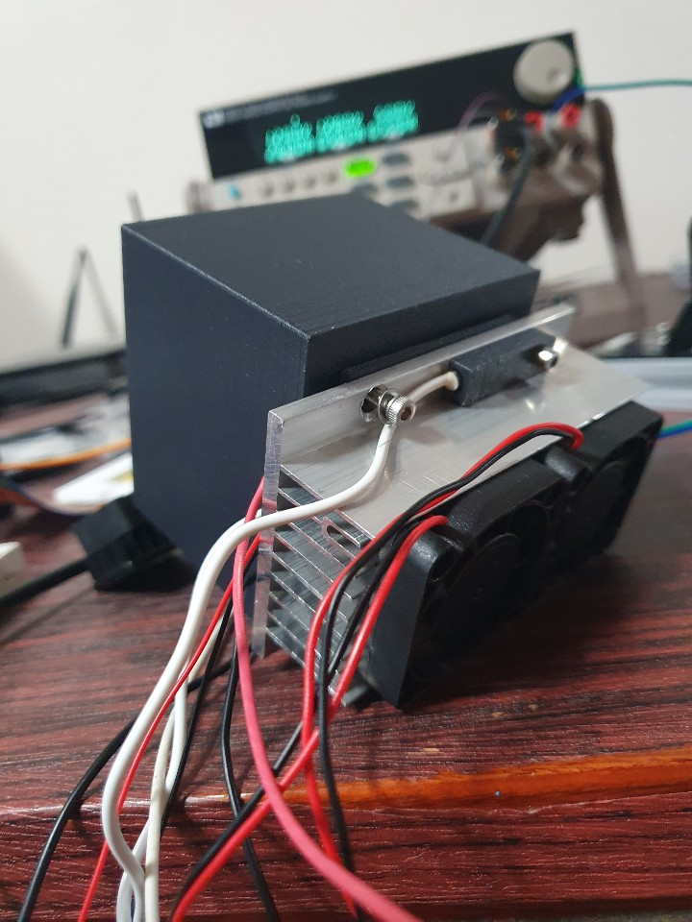
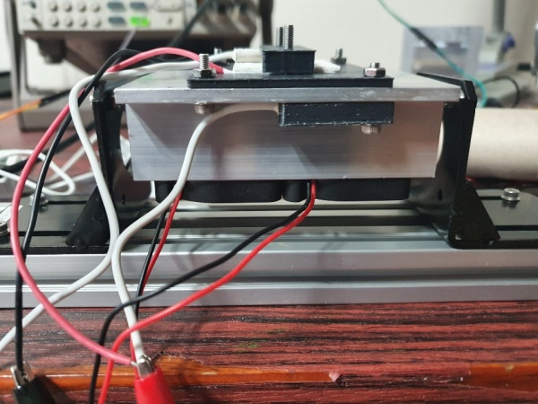
Experiment 2

Slide 7
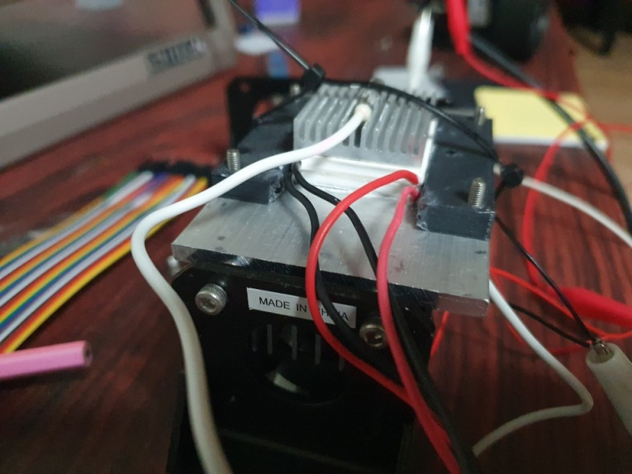
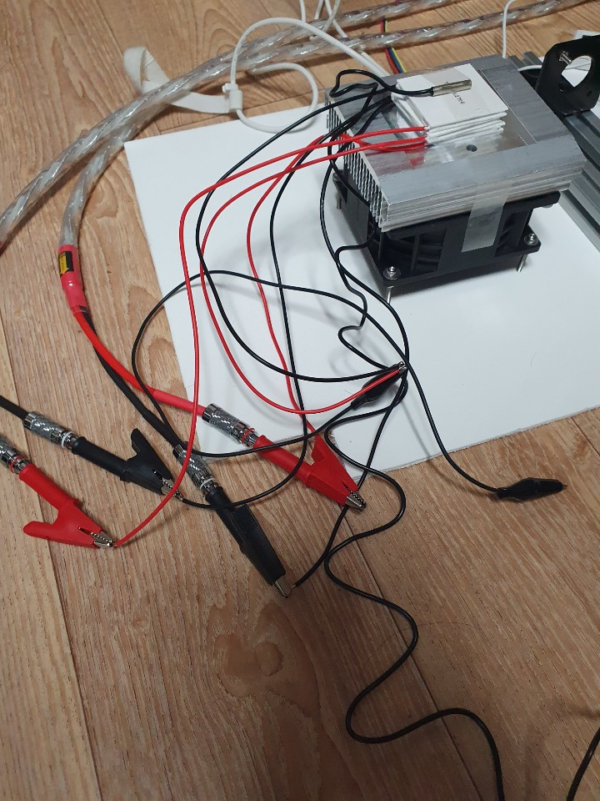
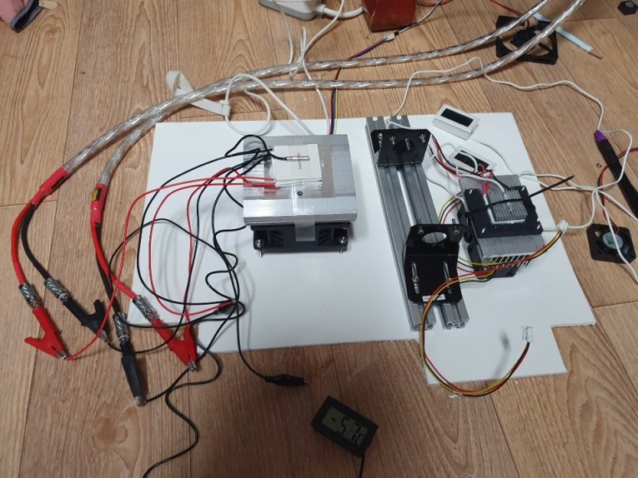
Experiment 3-1/2 stage, 3 stage

Slide 8
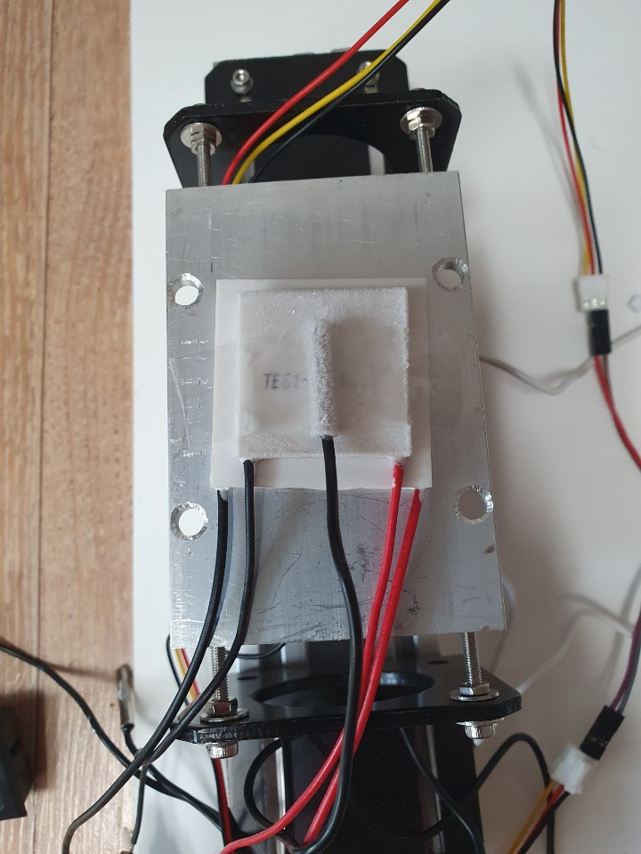
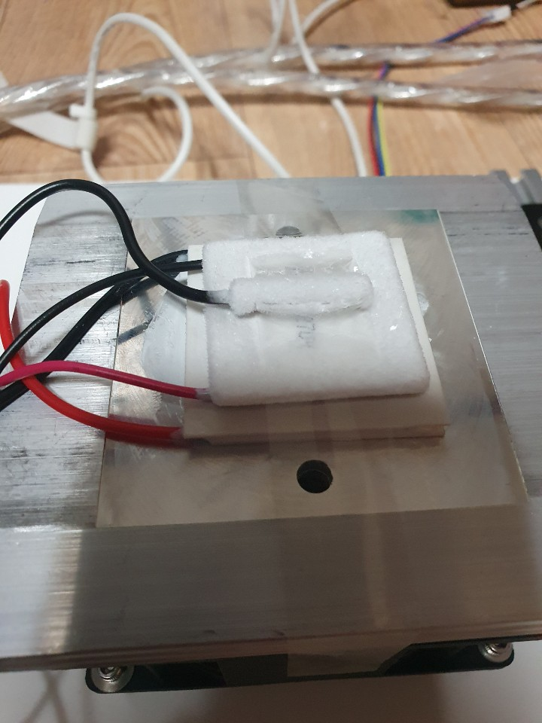
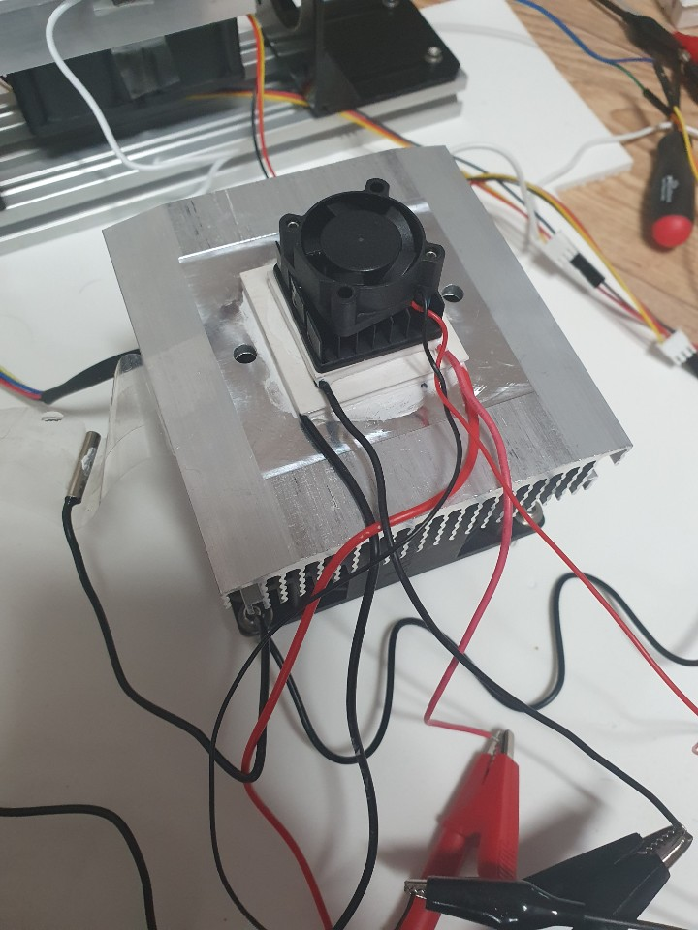
Experiment 3-2/4040, 3030 stack

Slide 9
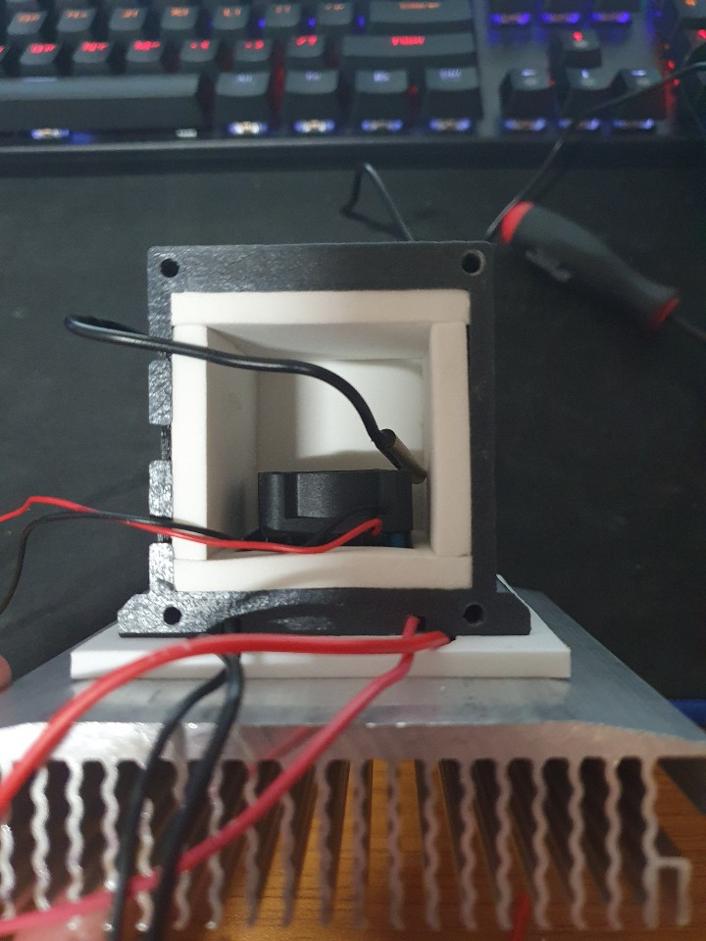
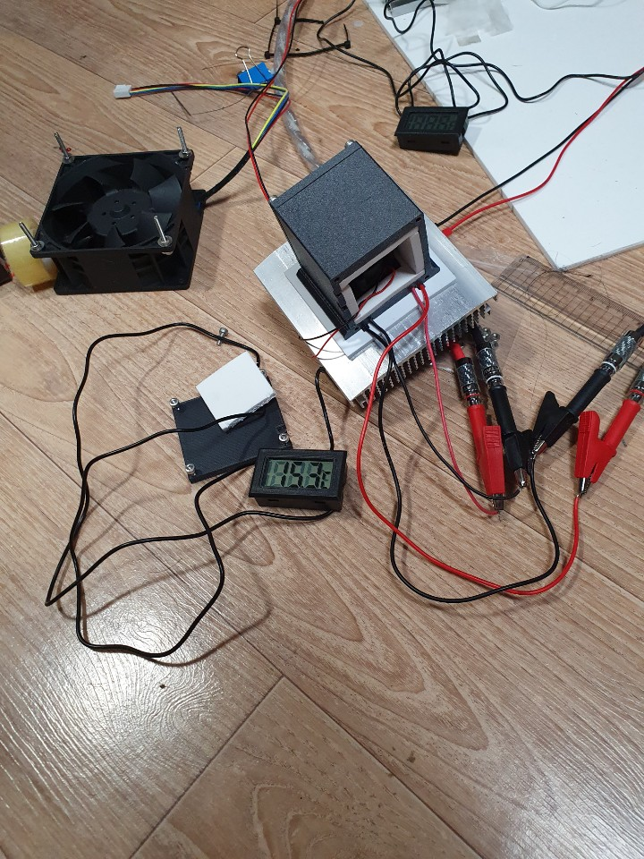
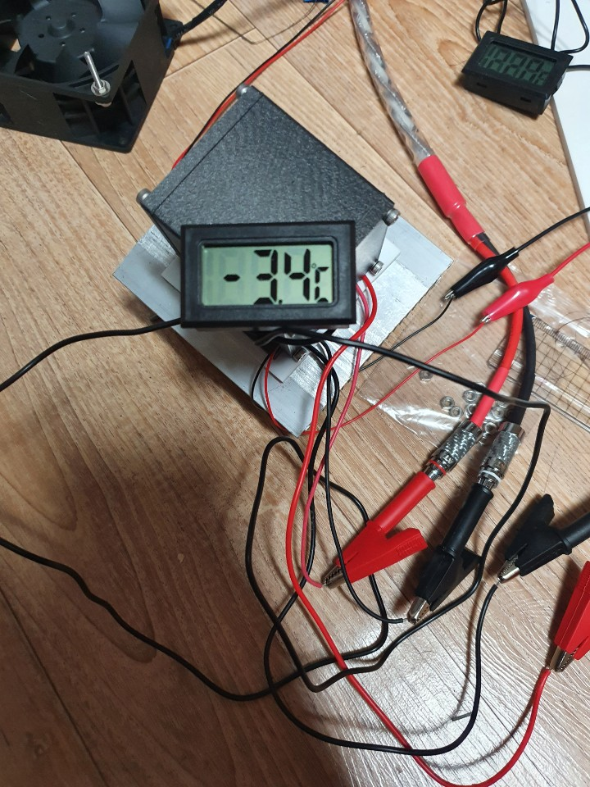
Experiment 3-3/chamber -3.4~-5C

Slide 10
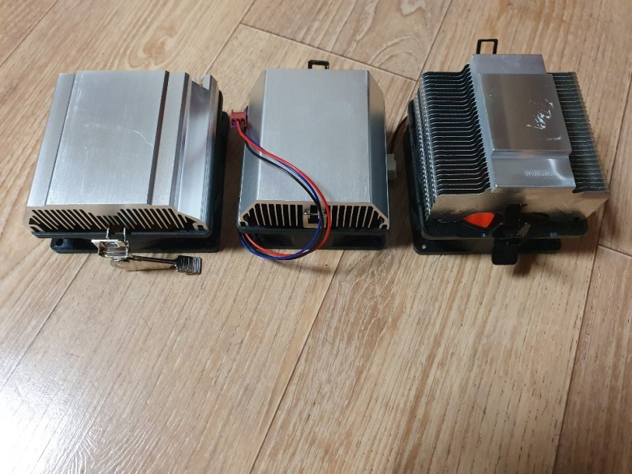
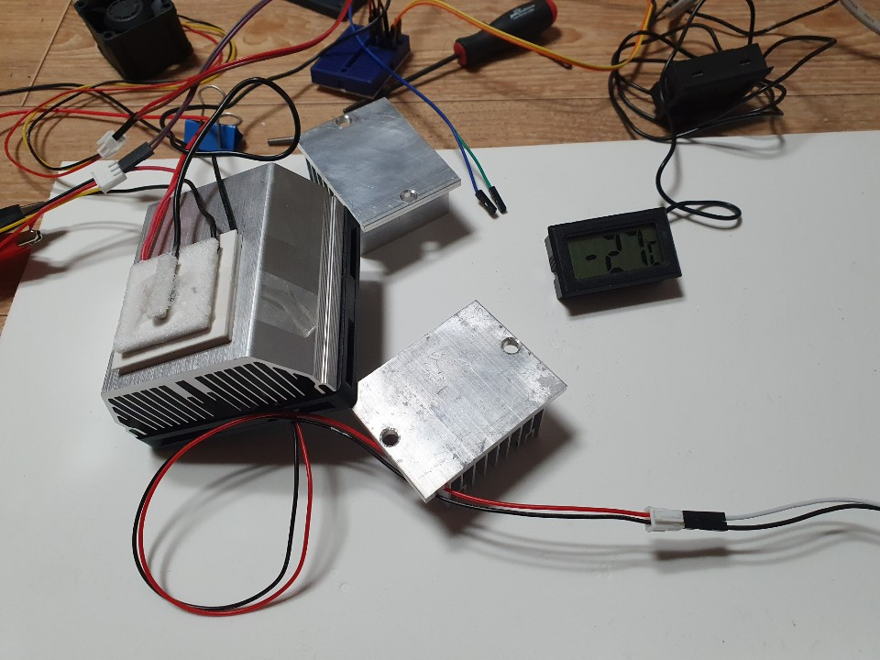
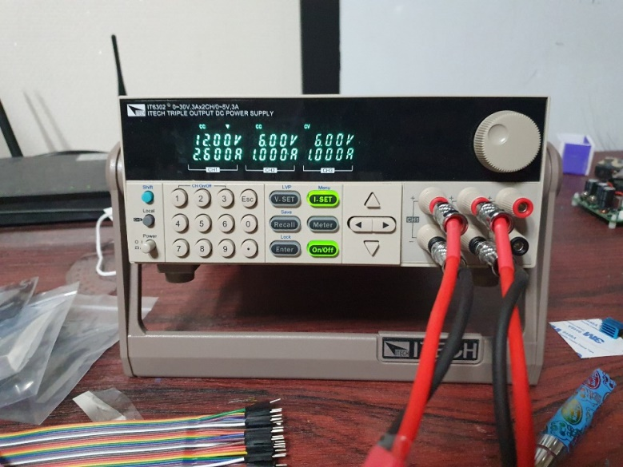
Experiment 4/-27C at 37.2W

Slide 11
Results Lowest: -27C(-16.6F)
90x60x24/3030 TEC(x2)/parallel 12V 5A, 40x10(x2) fan: 1.8C
100x95x24/4040 (x3)/bottom 12V 3A, middle and top series 12V 3A, 92x38: -6C
45x60x24/303012V 2.5A, 40x10: -7C
90x60x24/303012V 2.6A, 40x10(x2): -13C
100x95x24/4040 12V 2.6A, 3030 6V 1A, 92x38: -23C
77x77x30/4040 12V 2.6A, 3030 6V 1A, 80x10(3000 RPM): -27C

Slide 12
Thanks!

